Slide 1
Thread and Process Communication
Lecture 3 of 3
Mailboxes and Message Queues
Unix Style Sockets
Remote Procedure Calls (RPCs)
CORBA and DCom
Note: Examples of Mailbox/Message Queue concepts presented here can be found in the RTExamples folder: Q10
You are encouraged to open the project in Visual Studio and run the program
©Paul Davies 2020. Not to be copied, used, or revised without explicit written permission from the copyright owner. This lecture may contain animations and is best viewed as a slide show

Slide 2
Mailboxes/Message Queues
The final method of effecting inter process communication that we are going to take a detailed look at in this course is based around the concept of a Mailbox, also known as a Message Queue in some operating systems.
(See: http://en.wikipedia.org/wiki/Message_queue )
Mailboxes/Message Queues are supported by most OS’s such as Linux, Windows, Micrium uC/OS II and III for embedded microcontrollers etc.
Processes/threads can use mailboxes to post messages to other processes and threads in the system.
Message In
Message Out
MASCOT 3 Symbol for a Mailbox

Slide 3
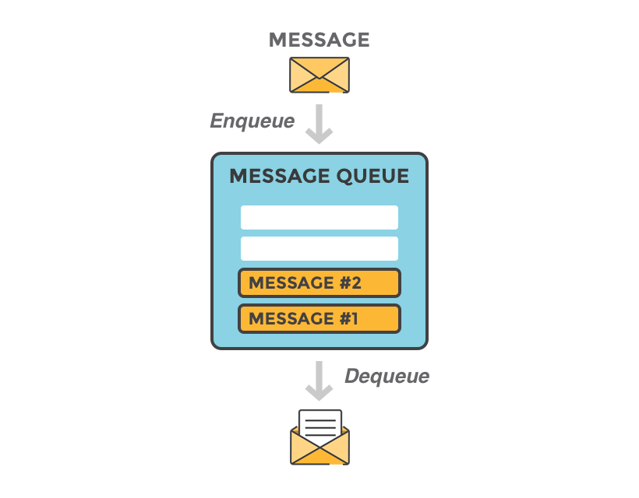
Concept
Write will append the new message to the end of the message queue. Writer is never suspended as queue can grow
Sender Posts Message
Message “type” varies between OS, but is often a simple int
Message Queue size is not fixed, on some OS’es it can grow. Is often implemented as a linked list which can be searched based on message priority
Read will return message at head of queue. If there are no messages, reader will be suspended. Reader can also search for a message
Read will remove a message from the message queue (size of queue may shrink).
Receiver Gets Message

Slide 4
What is a Windows Mailbox Message?
In Windows, a mailbox message is simply a 32 bit unsigned integer, sent by one process/thread to another in the system. Windows also uses messages to notify processes/threads about actions in the system such as keys being pressed or mouse buttons being clicked.(http://www.autohotkey.com/docs/misc/SendMessageList.htm).
We can use the same concept to send our own messages between our processes/threads. The message is usually interpreted by the receiver as status info or as a command/request to perform some action, rather than purely data. For example, in a small embedded microcontroller system:
  The message 1000 could ask the recipient thread to turn ON a light bulb in the living room.
  The message 1001 could mean turn OFF the light bulb.
  The message values 1000-1009 could be interpreted by an elevator to send elevator 1 to any of the floors 0-9.
  The message 4000 could mean ‘terminate’.

Slide 5
What a user message means and how it will be interpreted is entirely up to the sender and receiver threads to agree upon at design time.
There are no rules that say message ‘X’ means ‘Perform Action Y’.
Messages posted to a process/thread are stored in its mailbox and sit there waiting to be read by the receiver.
The recipient of a message cannot be forced to read its own Mailbox, so there are no guarantees that the message will be read at all (just like an email).
For more details on Windows message queues, check out
https://docs.microsoft.com/en-us/windows/win32/winmsg/messages-and-message-queues

Slide 6
Mailboxes: The RT Library CMailbox Class
A number of software primitives exist in the RT Library to construct and manipulate a mailbox. Look at the code in rt.cpp for details of how it interacts with the windows Kernel
  CMailbox() – Constructor for a mailbox.
  GetMessage() – Read/Search (and remove) a message from the mailbox.
  TestForMessage() – Check the mailbox for existence of any messages.
In addition, the CProcess, CThread and ActiveClasses each have the following member function. That allows a Parent process/thread to post messages to a child process/thread (see example later)
  Post() - Post message to child thread (see previous lectures).

Slide 7
Posting Messages
In order to post a message to a Process or Thread, you need to be able to identify the object (e.g. the CProcess, CThread or ‘Active’ object) that encapsulates or represents the process/thread/active object that you intend to send a message too.
This means that a parent can easily send messages to a child process/thread, (because it created the object/thread and can thus keep track of it) but it is not so easy for random/unrelated processes or threads to communicate using message queues. Maybe the use of a data pool or pipeline is more appropriate under those circumstances.
However, if you can arrange for the process/thread/active object in your program to be represented by global variables then any thread with access to those global variables can post messages to each other.

Slide 8
Creating a Mailbox class
Each process/thread wishing to receive messages must first create its own mailbox/message queue object to hold messages posted to them by other processes/threads. For example
int main()
{
  CMailBox MyMailBox ;
  …
  …
}
The mailbox/message queue is encapsulated within the CMailbox object and is created automatically by the constructor for the class.
Process main() or thread function within process or active class

Slide 9
Reading Mailbox messages: UINT GetMessage (int Min=0, int Max=0)
This function searches for and retrieves the first message from the mailbox that lies within the range of message values specified by Min and Max.
If no Min or Max arguments are given in the call e.g. GetMessage(), then Min and Max both default to 0 meaning the first message at the head of the mailbox is retrieved regardless of its value.
If the mailbox is empty, or there are no messages within the specified min-max range, then the thread attempting to get the message will be suspended until one arrives.
Note windows also sends messages to any active window including mouse and keyboard messages so a process with an open DOS window and a Mailbox will have to filter and remove these, otherwise they will accumulate.
This can be done by calling GetMessage() with no min/max values, thus you will get the first message in the mailbox. You can then determine if it is one you wish to respond to, or ignore it altogether, either way the message is removed. This approach is not necessary for processes or threads with no open 'Window' although it can of course be used.

Slide 10
Checking for Messages : BOOL TestForMessage (int Min=0, int Max=0)
This function allows the recipient thread to test for the presence of any message in its mailbox/Message queue that lies within the range of message values specified by Min and Max.
If no Min or Max arguments are given in the call e.g. TestForMessage(), then it tests for the presence of any message in the message queue.
It returns true (non zero) if at least one message in the specified range exists or false (0) otherwise.
This is useful in a polling situation (as we saw with pipelines) where you do not want to run the risk of suspending the recipient thread if its mailbox was empty.

Slide 11
Posting messages : BOOL Post ( int Message )
Post() will send the specified message to a process, thread or active object’s mailbox.
When it is posted to a ‘process’, (that may have multiple child threads) the messages ends up in the mailbox of the process’s main() or primary thread.
Caution: Do not let multiple threads share the same mailbox, let each have its own and if req’d, one thread can forward messages onto any other threads, just like email.

Slide 12
Posting a message to a Child Process or Thread
  int main()
  {
  CProcess Process1(……) ; // Create a child process
  CThread Thread1(…..) ; // Create a child thread
  Process1.Post(500) ; // send child process a message
  Thread1.Post(1000) ; // send child thread a message
  . . .
  Process1.WaitForProcess() ;
  Process1.WaitForThread() ;
  return 0 ;
  }
Parent Process
Object can be an instance of a process, thread or Active class

Slide 13
Creating a Mailbox and Polling for new messages in a process’s main thread
#include "rt.h"
int main() // main ‘process’ thread for the child process
{
UINT Message;
CMailbox MyMailBox; // create a mailbox for process main thread
// messages posted to this process will up in the main thread mailbox
CThread Child1(ThreadFn1, ACTIVE); // Create a child thread in Active state
do {
cout << "Child Process: Polling Mailbox\n";
Sleep(500); // sleep for 1/2 second
if (MyMailBox.TestForMessage() == TRUE) { // is there a message for me in mailbox?
Message = MyMailBox.GetMessage(); // if so, get the message
if (Message == 1000 || Message == 1001) // if message intended for thread1
Child1.Post( Message ); // forward message to thread1
else if (Message == 500) // otherwise I deal with it here
. . .
else if (Message == 501) // etc
. . .
}
} while (1);
Child1.WaitForThread();
return 0;
}
The Child Process main thread

Slide 14
Child Thread of Child Process
UINT __stdcall ThreadFn1(void *args)
{
UINT Message; // A variable to hold a message read from mailbox
CMailBox MyMailBox; // Create a mailbox object for this child thread
// Note each thread can create its own mailbox
do {
cout << "Child Thread 1: Suspending until a Message received\n";
if (Message = MyMailBox.GetMessage()) { // Get 1st message in queue
if (Message == 1000) // decide what message means
cout << "Turning Light Bulb ON...\n";
else if (Message == 1001) // if message = 1001
cout << "Turning Light Bulb OFF...\n";
}
} while (1);
return 0; // terminate child thread and mailbox
}
See Q10 – MessageQueuesAndTimers in RTExamples Folder

Slide 15
POSIX Message Queues
Message queues in Linux/MacOS and other POSIX systems work a bit differently than the Windows counterpart.
  Queues are created, given a named path e.g. /dev/mqueue/…
  Queues can be shared, unlinked, and closed
  Messages consist of a string with an associated integer priority
  Messages are delivered highest priority first, those with identical priorities are delivered in order of arrival.
  Programs can set up a callback function (like an interrupt handler) that is invoked automatically when a message is received. (Avoids polling)
For more details check out:
http://man7.org/linux/man-pages/man7/mq_overview.7.html

Slide 16

Inter-process/thread communication in a
“Distributed System” world

Slide 17
In today's increasingly sophisticated systems, more and more applications are being developed based on a distributed/networked architecture model, where the model is one of multiple processes/threads running on multiple computers connected remotely via a network, e.g. the internet, or some local private network.
The problem faced here is how to write an application that will allow a process on one computer to communicate with a process on another computer in a seamless, easy to use fashion.
Basically there are three commonly used approaches
  Unix style ‘Sockets’.
  Remote Procedure Calls (RPC).
  CORBA/DCOM Programming.

Slide 18
Unix Sockets (see http://en.wikipedia.org/wiki/Berkeley_sockets )
Unix Sockets is one of the fundamental S/W technologies upon which the internet is built.
Sockets provides an application programming interface (API) (i.e. a set of functions) to facilitate inter-process communication between a Client Program and a Server Program (typically, but necessarily limited, to running on different machines) over a network.
The interface is very low level and caters for sequential reads and writes of bytes of data, much like a pipeline or a serial port, but across a network.
Sockets is implemented on pretty much all operating systems, not just Unix.
Microsoft have produced their own version called WinSock2 (just to be different)
Good tutorial on UNIX sockets here
https://www.tutorialspoint.com/unix_sockets/ports_and_services.htm

Slide 19
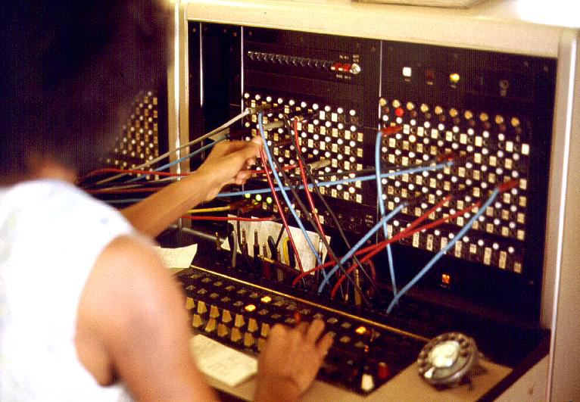

The term 'socket' was chosen because of the analogy with a telephone socket.

Slide 20
Clients communicate with servers (and vice versa) by creating a software ‘socket’ object (an instance of a ‘socket class’) in their code which specifies during construction
  The IP Address (e.g. 192.123.156.189) of the server that the client wishes to connect with (located anywhere in the world).
  A Port Number to identify a virtual channel or connection with an application/program running on that server.
An IP addresses is kind of like a country/region/business telephone number
A port # is analogous to a telephone extension number

Slide 21
Some Port Numbers are reserved for standardised communications protocols, i.e. they identify software running at the end of the port that expects to communicate in a specific way, i.e. how it interprets the data.
  For example when you type HTTP into your browser, it will attempt to connect to Port 80 of the machine at the specified IP address. If you specify HTTPS, it will use port 443 because data at the end of the port uses encryption
  Dynamic ports (private ports) that you can use are 49152 to 65535
  Note: A good method of spreading viruses is to write a client that will probe random IP addresses and Port numbers looking for a program to communicate with that will enable it to gain access and infiltrate your Machine. A fire wall is pretty much essential to block unused ports and clients and warn the user of unsolicited communications.
Port | Description
20 | FTP -- Data
21 | FTP -- Control
22 | SSH
80 | HTTP
143 | Interim Mail Access Protocol (IMAP)
443 | HTTPS

Slide 22



What happens on the Server Side of a Socket Connection?
The server main thread
  Creates its own “socket”
  Opens a port on that socket (application dependent e.g. 52001)
  Listens for incoming connection requests (from clients) on that port,
  Accepts a client connection (often creating a child thread to service it)
  Communicates with the client using low-level read/write operations.
During and after the connection is made from the client, the original port and main server thread are still free to listen for new clients.
Client
socket
socket
Client
socket
Server :52001
socket
socket
Client
socket
PIPES AND SOCKETS

Slide 23
What happens on the Client Side of a Socket Connection?
  Creates a “socket” of its own.
  Connects to a server using an IP address and a Port number to identify the machine and program that it wishes to talk to.
  Communicates with the server program using low level read() and write() functions similar to those for a pipeline to transfer low level, raw bytes.
  Closes the connection when communication has finished.
For a simple, quick primer on socket programming, and some sample Unix/Windows based C code take a look 1) http://webdocs.cs.ualberta.ca/~paullu/C379/jim.frost.sockets.html
2) Unix https://www.geeksforgeeks.org/socket-programming-cc/
3) Winsock https://www.binarytides.com/winsock-socket-programming-tutorial/
4) https://docs.microsoft.com/en-us/windows/desktop/winsock/finished-server-and-client-code
You tube video https://www.youtube.com/watch?v=LtXEMwSG5-8
Server, could also be your program
Client application , e.g. Web browser such as Internet Explorer or your program
Applications running on the server each using a unique port number and socket but share the same IP address
FTP server: Port #21
Telnet server: Port #23
Create Socket()
Connect(192.234.567.890, 80)
Read()
Write()
Web Server: Port #80
Socket
Socket
Internet acts as a multi-channel conduit
Server IP Address
192.234.567.890

Slide 24
Sockets and Remote Procedure Calls (RPC)
Sockets can be used to implement something called remote procedure calls in a distributed system. Here, the client calls a function that looks like the one it wants to run on the server, i.e. a proxy for the real server function. The proxy sends data identifying its real counterpart on the server, along with any data/parameters that it might need.
The server receives the message and data and invokes the real function within the server application to carry out the action, while passing back any results to the client.
(see http://en.wikipedia.org/wiki/Remote_procedure_call)
Good intro/overview here https://www.cs.rutgers.edu/~pxk/416/notes/17-rpc.html
Server
Command = 10 might mean insert into database, the other argument might be the data to insert, e.g. 20
Application: Port 100
interprets incoming data as Commands + Arguments and returns results
Client
Create Socket()
Connect(192.234.567.890, 100)
Write (10);
Write (20) ;
X = Read()
10, 20
Socket
Read() and Write()
Socket
Result of operation passed back, e.g. 1=OK, 0=Failed
Server IP Address
192.234.567.890

Slide 25
Object Oriented Communication in a Distributed Object World: CORBA and DCOM

Slide 26
In Object Oriented Programming languages like C++/Java etc. we have seen how objects communicate through a process know as message passing, where one object directly invokes a member function of another object to get it to perform an action or operation.
That technique works fine if the communicating objects are part of the same process, but not in a networked/distributed world. How for example could an object on one machine directly invoke a member function within an object residing on another machine half way around the world?
System Boundary
An Active Class
An Active Class
class MyClass1 : public ActiveClass
{
func1() { ….. }
func2(int p1, int p2 ) {….. }
func3() { ….. }
int main()
{
MyClass2 Object2 ;
int x = Object2.func1(p1, p2);
}
};
class MyClass2 : public ActiveClass
{
int func1(int p1, int p2) { ….. }
void func2() { ….. }
void func3() { ….. }
int main()
{
MyClass1 Object1 ;
int x = Object1.func2( p1, p2);
}
} ;
Direct method invocation
Traditional Object Oriented Approach
Objects within the same system communicating via direct method/Member Function invocation

Slide 27
Communicating in a Distributed Object World: CORBA and DCOM
More and more applications are now being developed where the communicating objects that form the application are being distributed, not only amongst other processes in the same machine, but perhaps around the world where they exist on different computers. Such a scheme makes the direct message invocation scheme that we have traditionally used in C++ etc. difficult if not impossible.
One solution would be to use sockets/RPC but it’s not very elegant and the cracks in the model are all too apparent (i.e. the need for IP addresses and port numbers etc. and reading/writing raw bytes is not particularly object oriented).
The Common Object Request Brokerage Architecture (CORBA) is an open standard defined by the Object Modelling Group (OMG). DCOM is Microsoft's own proprietary rival to CORBA although they also have “.Net” which has largely superseded DCOM.
Both CORBA and DCOM define a model for communication between objects in a distributed object architecture, that is, objects existing either on the same machine or on different machines located anywhere in the world.
The beauty of CORBA is that it is programming language and operating system independent, letting you mix them all into one distributed melting pot.
(See: http://en.wikipedia.org/wiki/Corba )
https://www.corba.org/orb_basics.htm

Slide 28
Communicating with CORBA (cont…)
In distributed computing, an object request broker (ORB) is installed middleware that sits between client and server) which allows program calls to be made from one computer to another via a computer network, providing location transparency through remote procedure calls. (Source Wikipedia)
CORBA protocols allows applications to be developed in such a way that a process is able to locate any object in the world and talk to it (i.e. send it messages) as if it were talking to that object directly i.e. as if the object were part of the same program running on the same machine.
The technology is complex so this is just an overview.
First the developer uses an “IDL” compiler to create proxy (or dummy) objects locally on both the client and server machines with interfaces identical to the real objects on the remote machine (same function names, arguments, returned data etc.)
The client application communicates with the local proxy object, which in turn communicates with an ORB (object request broker – a bit like a telephone directory). Through the ORB, objects written in different languages on different machines with different operating systems can communicate with each other.
The proxy object on the client machine then communicates with the proxy on the server (using technologies like sockets/RPC). Thus it is the proxy on the server that carries out the actions of the client ON the server.
For good overview see http://docstore.mik.ua/orelly/java-ent/jenut/ch04_01.htm

Slide 29
Object 1
Proxy classes are designed to emulate the real object in another system. That is it has the same member functions with identical parameters and return type.
Objects on one system communicate with their (local) proxy whose job it is to marshal parameters and returned data between the real objects
The ORB allows objects to be located and to be registered for use in the world with an object service provider (like yellow pages) where ORBS can go to register their objects and find objects of the type they want. (see https://www.ibm.com/support/knowledgecenter/en/SSMKHH_10.0.0/com.ibm.etools.mft.doc/bc22420_.htm)
Object 3
Client machine in UK
Server In Canada
MyActiveClass2
MyActiveClass1
int func1(int p1, int p2) { ….. }
void func2() { ….. }
void func3() { ….. }
int main()
{
. . .
}
int func1() { ….. }
int func2(int p1, int p2) { …..}
int func3() { ….. }
int main()
{
int x = Object3.func1(p1, p2);
}
int
Object 1 communicates with object 3 via the proxy
Object 3 communicates with object 1 via the proxy
p1,p2
Proxy for Object 3 in Canada
Proxy for Object 1 in UK
int func1(int p1, int p2) { ….. }
void func2() { ….. }
void func3() { ….. }
Object
Naming
Service
int func1() { ….. }
int func2(int p1, int p2 ) { ….. }
in tfunc3() { ….. }
Object
Locator
Locate
Register
ORB
Result: int
ORB
internet
Parameter: p1,p2
Method: func2()

Slide 30
Example
Imagine a smart home with a computer (the Server) that controls, say, lights in a room.
Imagine also developing say a mobile “app” on an Android phone using CORBA/DCOM (the client)
The distributed software architecture might look like this

Slide 31

Proxy classes are designed to emulate the real object in another system. That is it has the same member functions with identical parameters and return type.
Objects on one system communicate with their (local) proxy whose job it is to marshal parameters and returned data between the real objects
The ORB allows objects to be located and to be registered for use in the world with an object service provider (like yellow pages) where ORBS can go to register their objects and find objects of the type they want. (see https://www.ibm.com/support/knowledgecenter/en/SSMKHH_10.0.0/com.ibm.etools.mft.doc/bc22420_.htm)
Android App
Smart Home Server
BulbOn(int room) { ….. }
BulbOff(int room) { ….. }
int main()
{
. . .
}
int main()
{
Home.Connect();
Home.BulbOn(0);
Home.BulbOff(5);
}
App communicates with smart home via the proxy
Proxy Object for Home
Real Home Object
BulbOn(int room) { ….. }
BulbOff(int room) { ….. }
Object
Naming
Service
void BulbOn(int room) { …. }
void BulbOff(int room) { …. }
Object
Locator
Locate Home Object
Register Home Object
ORB
Result: int
ORB
internet
Parameter: room
Method Number: BulbOn() or BulbOff()

